Slide 1
Presentation on
GIS based Property and Infrastructure Asset Management Systems (GIS-PIAMS)

Slide 2
Objectives of Assignment
02
Design, Develop and Commissioning of GIS-PIAMS
Property
P
Management
M
Infrastructure
System
I
S
Asset
A

Slide 3
GIS-PIAMS will consist of
03
Financial Management
Infrastructure Asset Management
Inter-Operability with Existing Systems
Analytical Functionality
Convergence and Consolidation of Information
Communications Interface

Slide 4
Financial Management
Process the local revenue and expenditure cycle within the system
Tax assessment
Printing and issuance of notice
Issuance of invoice
Recording of payments
Generation of financial data that the ULB can use in Revenue projection
Resource programming and budgeting.
Electronic expense recording across the various units of the ULBs
Facilitate the consolidation of expenditures.

Slide 5
Infrastructure Asset Management
Asset inventory Road, Water and Drainage System etc.
Interface with the capital investment program
Interface with the budgeting process
GIS based analytical tools to improve infrastructure asset management.
Support proactive asset management

Slide 6
Inter-Operability with Existing Systems
04
Data sharing, migration and use of data across related systems.
Interface with available systems
Simplify data sharing
Improve data access
Facilitate decision-making
Facilitate public outreach

Slide 7
Analytical Functionality
05
Process and analyse data
Analytical information related to revenue collection efficiency
Information about the performance and management of revenue services and assets
Capacity to simulate conditions considering changing scenarios for key indicators.

Slide 8
Convergence and Consolidation
of Information
06
consolidation of data from ULBs to upwards.
The consolidated information should allow for macro-level analysis.
Options for sharing information with other concerned agencies
Interface with the public to promote stakeholder participation.

Slide 9
Communications Interface
07
Interface with other modes of communication
Facilitate automated email of tax notices to concerned taxpayers
Collaboration with Government agencies to oversee disaster management
Web-based interface with the public to promote stakeholder participation

Slide 10
PHASES
08
Phase | Task | Duration (18Month) | Start Date | End Date
1 | Needs Assessment and Database Development | 7 | 31/05/2017 | 30/12/2017
2 | Design and Development of the GIS-PIAMS | 7 | 31/12/2017 | 30/07/2018
3 | Piloting and Replication (Scale-Up) of the GIS-PIAMS | 4 | 31/07/2018 | 30/11/2018

Slide 11
12
PHASE-1: Methodology
Phase 1 | Personnel Involved | Methodology | Deliverables
Needs Assessment and Database Development | K-1 Project Team Leader (PTL), K-2 Lead GIS Specialist/Systems Specialist, K-3 Lead Database Management Specialist, K-4 Local Government Development Specialist, K-5 Economist/Public Finance Specialist, K-6 Capacity Development Specialist | Interview Review of the secondary source Conceptual Data Modeling (ER) Logical Modeling (ER to Relational) Physical Database | Inventory of agencies and projects using GIS technology for urban management Database Schema

Slide 12
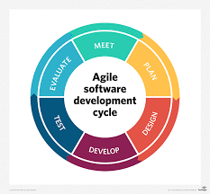
PHASE-II: Methodology
64
Phase II | Personnel Involved | Methodology | Deliverables
Design and Development of the GIS-PIAMS | K-1, K-2, K-3, K-5, K-6 CDS, AGS , DE, FIS |  | System Requirement Specification (SRS), Design Prototype, GIS-PIAMS Model GIS-PIAMS Software Testing & Implementation Report, Demonstration and feedback from target users Operational Manual

Slide 13
PHASE-III: Methodology
Phase II | Personnel Involved | Methodology | Deliverables
Piloting and Replication (Scale-Up) of the GIS-PIAMS | K-1, K-2, K-3, K-5, K-6 Capacity Development Specialist, Associate GIS Specialist, Database Encoders, Field Information Surveyors (FIS) | The Windows Installer architecture Experimental experience & simulation TOT Interactive Workshops | GIS-PIAMS Pilot Installations in 2 ULBS, GIS-PIAMS Trial Operation and Turn Over, Development of Scaling Up Strategy, Conduct Workshop on GIS-PIAMS, ULB Orientation and Enrolment, GIS-PIAMS Installations, Trial Operations and Turn Overs, Development of Nationwide GIS-PIAMS Roll Out Strategy, Conduct of Project Completion Conference

Slide 14
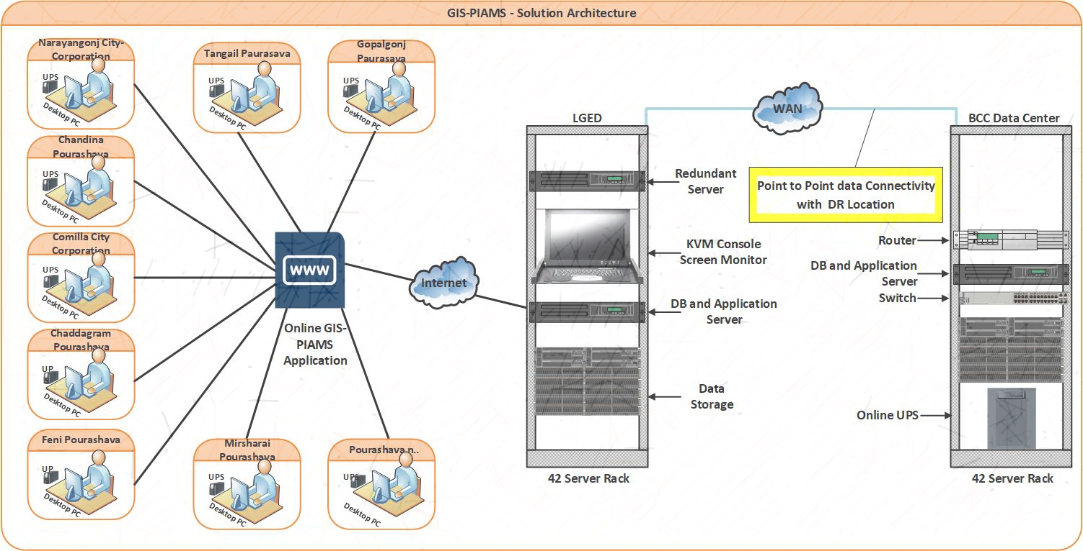
SOLUTION ARCHITECTURE

Slide 15
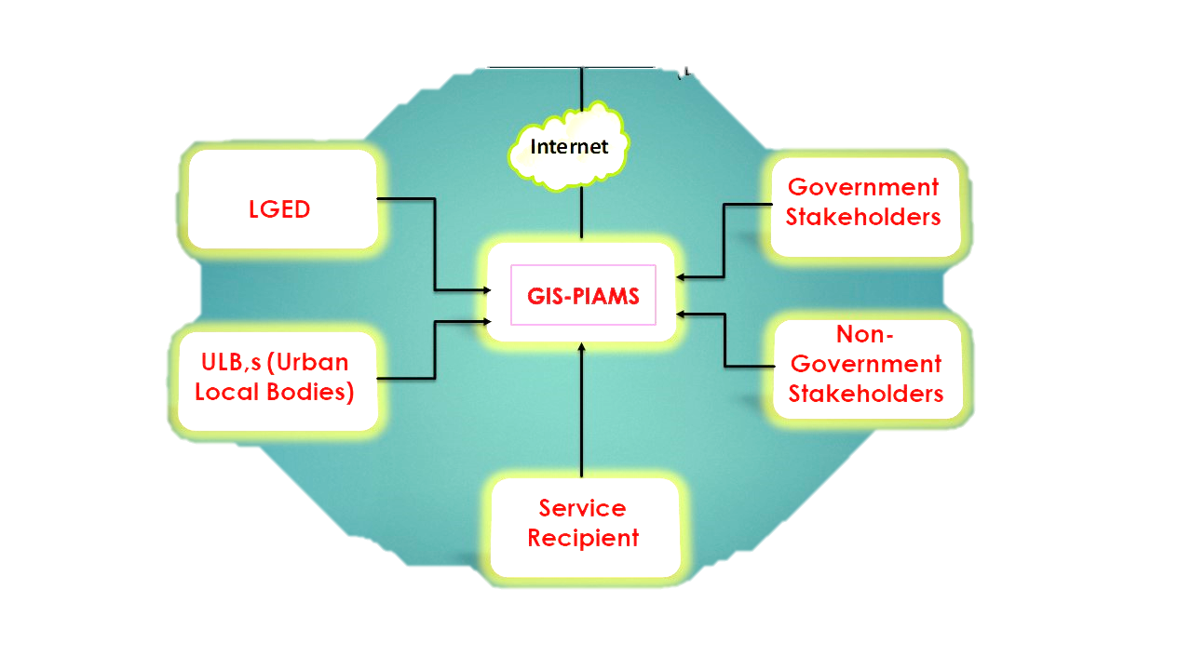
Stakeholders of GIS-PIAMS

Slide 16
Technology and tools
Languages : Visual Basic.Net
Databases : MS SQL Server 2016
Web/Application
Servers : Windows IIS
Reporting tool : Dev Express
Methodologies : Agile
Browser : Internet Explorer, Firefox, Safari, Chrome and Opera
Map Integration Technology : ArcGIS Server
Font/Languages : Bangla and English

Slide 17
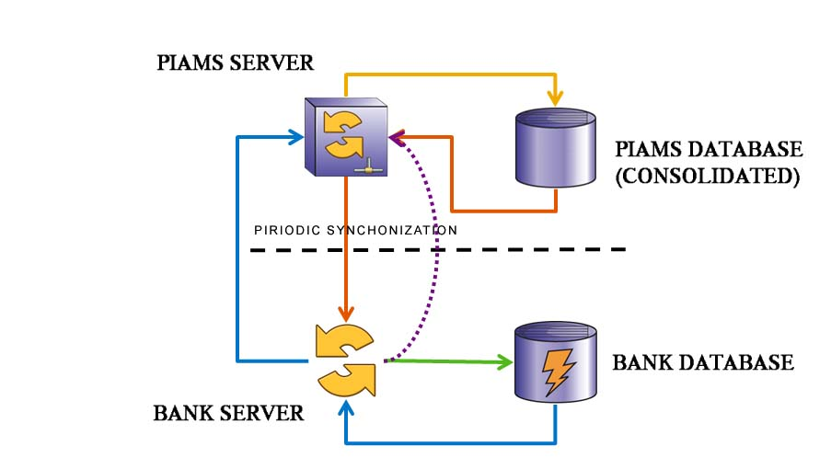
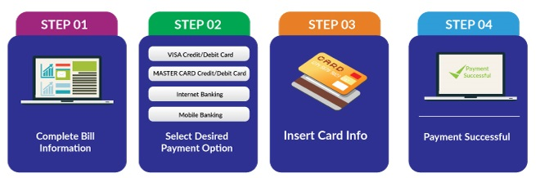
ONLINE PAYMENT
GATEWAY INTEGRATION
Bank Payment
Online Portal Payment

Slide 18
Scope of GIS Integration
Parcel Information (Holding’s Area)
Household
Roads
Bridge and Culvert
Drain
Social Infrastructures
Infrastructure
Pipe Line (Water)
Utility (Street Pole)
Waterbody
Waste bin capacity
FAR, Set back and Tax Assessment
Infrastructure Inventory
and O & M
Service Facility Analysis
Suitable site analysis

Slide 19
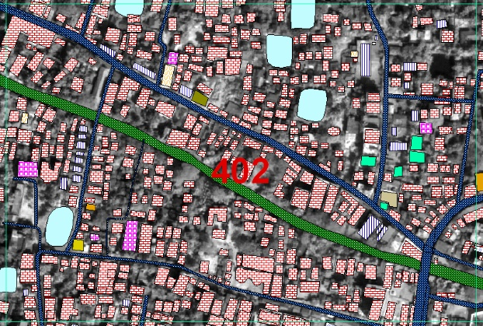
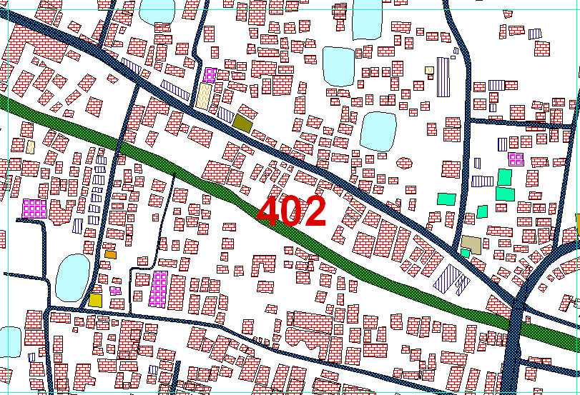
Survey Involvement
Baseline survey using RTK-GPS static method
Baseline data processing and network adjustment
Topographic features survey
Physical features survey
Land use survey

Slide 20
GIS Survey Flow Diagram
Asset
Secondary Data Collection
Maps and Database
Review Document
Decoding Secondary Data
Physical Feature Inventory
Text Document
Master Plan Docs
Rules & Regulations
Manuals
Physical Feature Maps
Detail area Maps
Geo-database
Satellite image procurement
Map Preparation with Decoding Data
Map Preparation with Decoding Data
Identify Feature
Map Print for Surveying
Re-projection
Recode
Geo-referencing
Field Survey (Detail)
Digitization
GIS Database Preparation
GIS Map Preparation

Slide 21
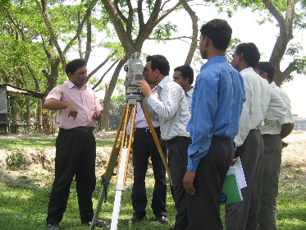

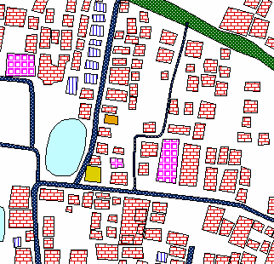
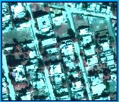
GIS BASED TAXATION
Relating GIS attribute according to tax schedule
Create a reliable property database through TS survey and door to door interview of KIS
Prepare GIS interface for Tax Assessment System
TS survey
Door to Door
Survey

Slide 22
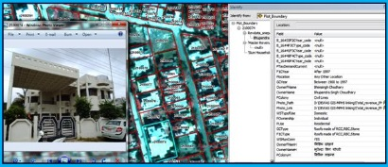
Outcomes / Results
A comprehensive database will be created of all properties including all property tax assessment parameters.
Un-assessed, under-assessed, over-assessed property taxation will be identified.
Established link between property location onto GIS map and its corresponding property details with photograph to get reliable impression or evidence

Slide 23
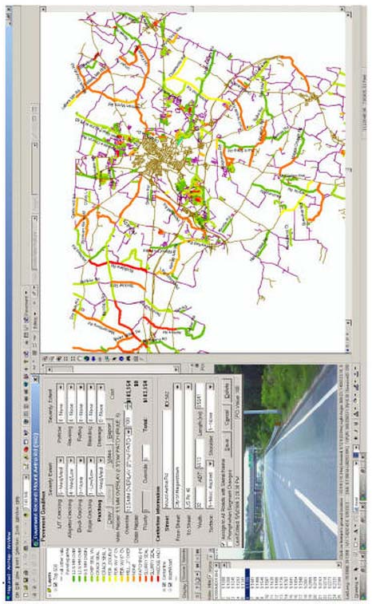
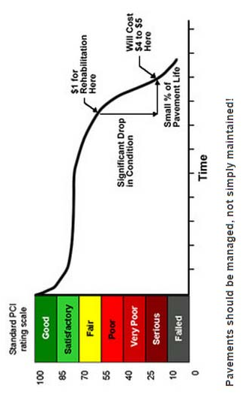
Road Inventory
Planning and design
Operations and maintenance

Slide 24

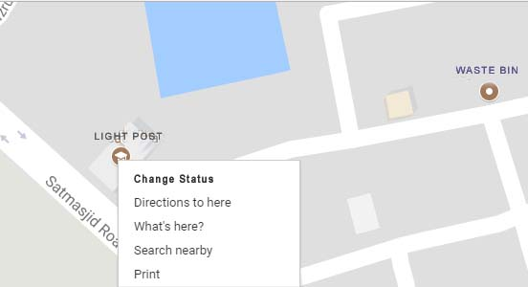
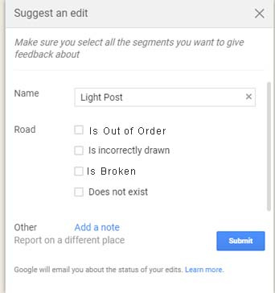
GIS-PIAMS for O&M
Predictive maintenance
Better workforce planning
Improve productivity

Slide 25

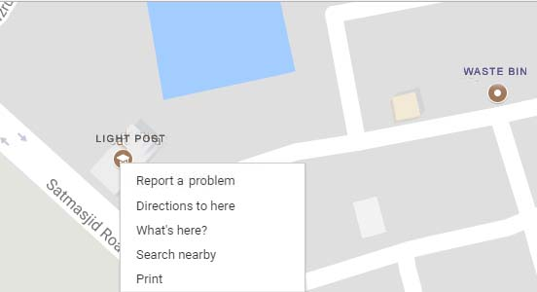
GIS-PIAMS fro Community based City Management
Citizen Contribution
ULBs post in social media

Slide 26
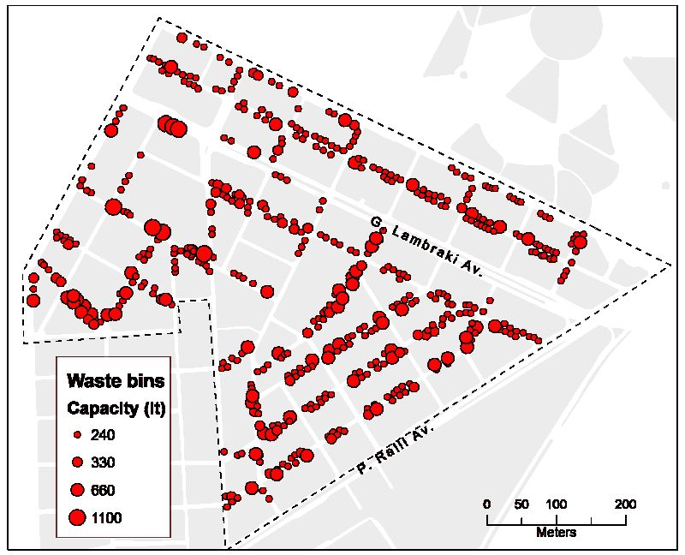
Optimum Location of
Waste bin distribution
Planning and design
Operations and maintenance

Slide 27
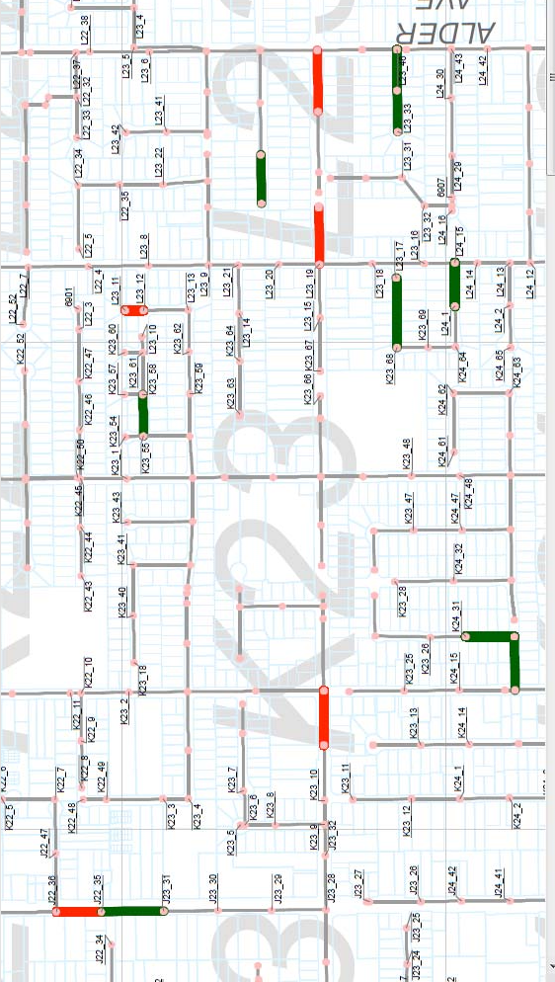
Water Supply Lines
by defect Ratings
Water Supply Challenges:
Aging Networks
Water Shortages
Energy and Water Losses
Insufficient Network
Visibility

Slide 28
Design Status of GIS-PIAMS
SRS (System Requirement Specification)
DFD (Data Flow Diagram)
Development Status
Proto Type
Development on Going
Expected Completion Date 30/07/2018

Slide 29
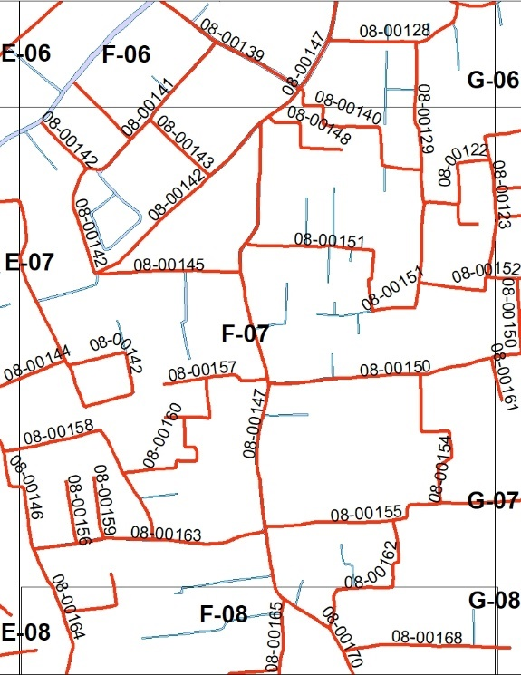
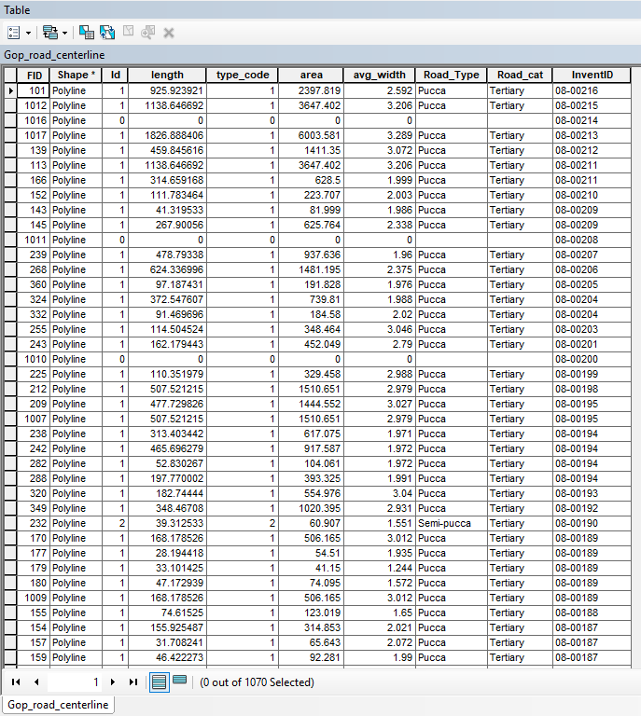
Road Inventory Status
Findings
Gopalgang
63% Road found
without Inventory ID
Tangail
On Going

Slide 30
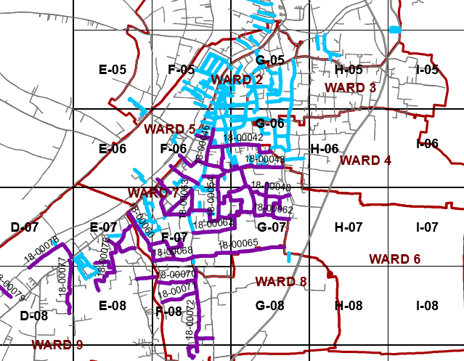
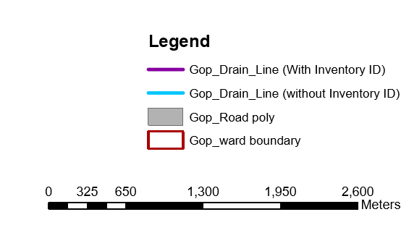
Drain Inventory Status
Findings
Gopalgang
65% Drain found
without Inventory ID
Tangail
Yet On Going

Slide 31
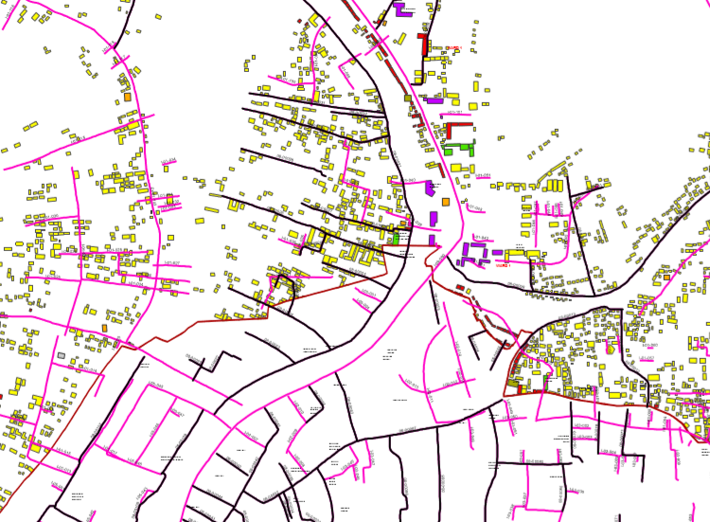
Household Survey
Findings
Gopalgang
On Going
Tangail
On Going

Slide 32
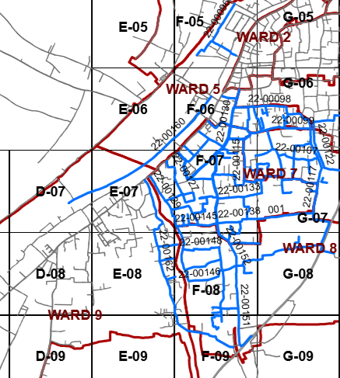
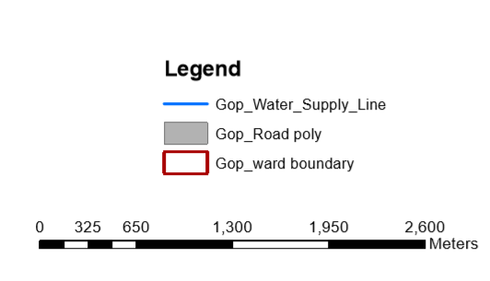
Water Supply Network Survey
Findings
Gopalgang
Completed
Tangail
On Going

Slide 33
Thanks & Bye

